Slide 1
Deployment of RobotSDK_v3.0
Mengwen He
2014-09-02

Slide 2
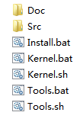
RobotSDK_v3.0 Package
Doc | Documentation from Doxygen
Src | Source Code
Install | Batch to Install Tools and Kernel
Kernel | Batch/Shell to Build Kernel
Tools | Batch/Shell to Build Tools

Slide 3
Prerequisite
Windows
VS 2005~2013
Qt 5 *
qt-vs-addin **
Boost ***
Linux
Qt Creator
Qt 5
Boost
* Qt’s version should be consistent with VS.
* http://qt-project.org/downloads or you could compile Qt as appendix A
** qt-vs-addin should support Qt 5
** http://qt-project.org/downloads
*** Boost’s version should be consistent with VS.
*** http://sourceforge.net/projects/boost/files/boost/

Slide 4
Deployment on Windows

Slide 5
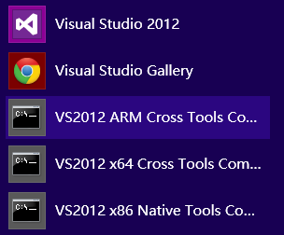
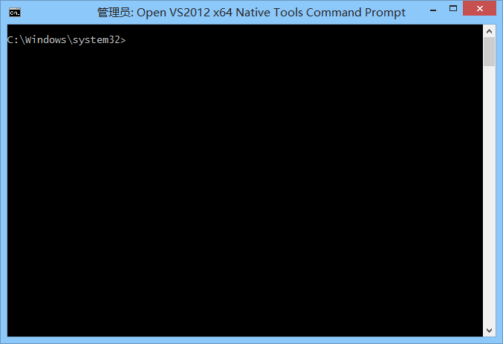
Visual Studio Command Prompt
A tool of Visual Studio
x64 version will use x64 compiler
x86 version will use x86 compiler
Located in Visual Studio menu
Used to compile Tools and Kernel
Please start with administrator

Slide 6
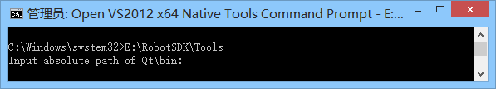
1. Build Tools (1/2)
Start VS command prompt with administrator
Run following commands
(assume RobotSDK_v3.0 package is in E:\RobotSDK)
cd /D E:\RobotSDK
(assume Qt is installed in D:\SDK\Qt)
Tools D:\SDK\Qt\bin
Or directly run following commands
E:\RobotSDK\Tools D:\SDK\Qt\bin
Or without parameter
E:\RobotSDK\Tools
Then it may require to specify the Qt\bin folder as below

Slide 7
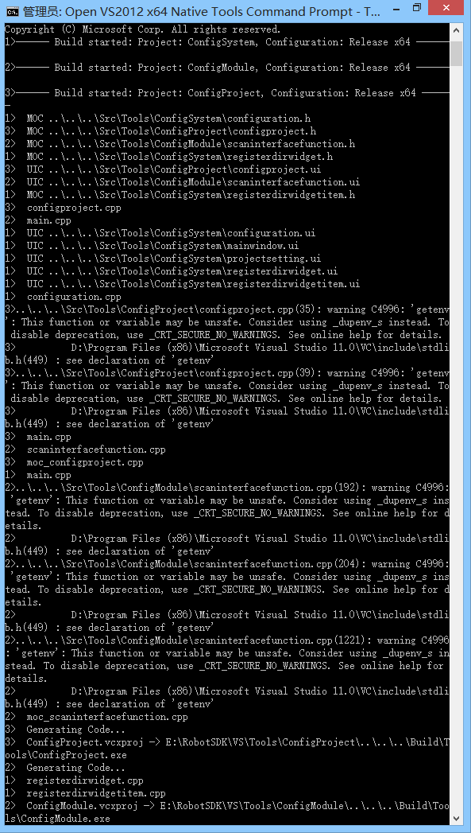
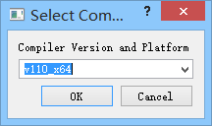
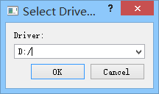
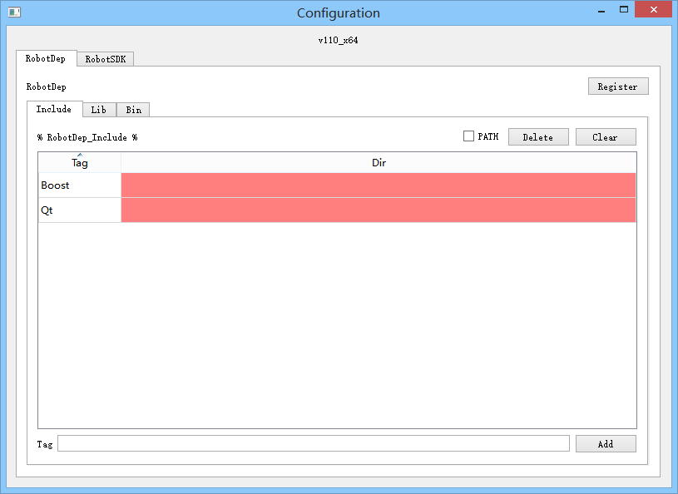
1. Build Tools (2/2)
Start to compile Tools as right
Automatically launch ConfigSystem.exe
Select Compiler Version and Platform (appendix B)
Select Driver to install RobotSDK
(assume select D, it will be in D:\SDK\RobotSDK)
Start to configure system environment
On RobotDep Tag, Boost and Qt must be set
On RobotSDK Tag, it could not be modified
Press “Register” button on both tags
Confirm everything is registered
Close ConfigSystem.exe

Slide 8
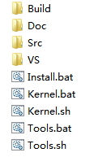
1. Tools Building Completed
Build | Output Directory of Tools Applications: ConfigSystem.exe ConfigModule.exe ConfigProject.exe
VS | Output Directory of VS Project: Tools.sln ConfigSystem.vcxproj ConfigModule.vcxproj ConfigProject.vcxproj
ConfigSystem.exe could finish configuration for one time
After configuring system environment, reboot is not necessary
Tools Building is the prerequisite of Kernel Building

Slide 9
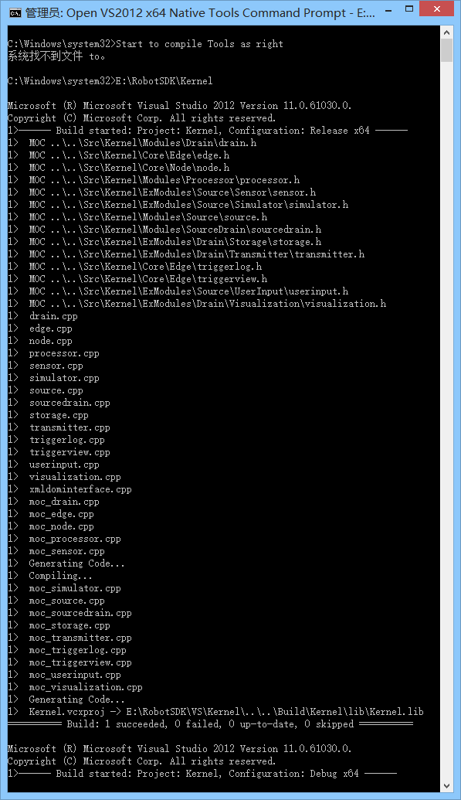
2. Build Kernel
Start VS command prompt with administrator
Run following commands
cd /D E:\RobotSDK
Kernel
Or directly run following commands
E:\RobotSDK\Kernel
Start to compile Tools as right

Slide 10
2. Kernel Building Completed
Build | Output Directory of Kernel: include Kernel headers CreateRule.xml Interface_Functions.xml RobotSDK_Global.h lib Kernel.lib Kernel_Debug.lib
VS | Output Directory of VS Project: Kernel.vcxproj
Original Kernel’s static link libraries are compressed into one Kernel.lib
Support VS 2005 to 2013

Slide 11
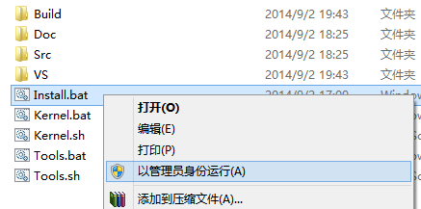
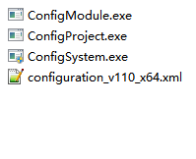
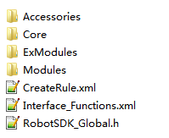
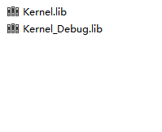
3. Install
Start Install.bat with administrator as below
Everything will be installed to D:\SDK\RobotSDK
Tools
Kernel\include
Kernel\lib

Slide 12
Appendix

Slide 13
Appendix A
Install ActivePerl and python
Add python’s directory to PATH
Start VS command prompt with administrator
Create ConfigQt.bat* in the folder of Qt’s source code
Run ConfigQt.bat
Run nmake
Run nmake installs
* ConfigQt.bat see next page.

Slide 14
Appendix A (ConfigQt.bat)
@echo off
if "%1"=="" cd /D %~dp0
if not "%1"=="" cd /D %1
set /p driver=Set Disk Driver for Qt Installation (default: c):
if "%driver%"=="" (set driver=c)
set QTDIR=%driver%:\SDK\Qt
set PATH=%PATH%;%QTDIR%\bin
set /p vsversion=Set VS Version (default: 2012):
if "%vsversion%"=="" (set vsversion=2012)
set QMAKESPEC=win32-msvc%vsversion%
configure -prefix %QTDIR% -debug-and-release -opensource -opengl desktop -nomake examples -nomake tests
pause
@echo on

Slide 15
Appendix B
VS Version | Compiler Version | _MSC_VER
2013 | v120 | 1800
2012 | v110 | 1700
2010 | v100 | 1600
2008 | v90 | 1500
2005 | v80 | 1400

